Slide 1

Chapter 21
File Transfer:
FTP
and
TFTP
Copyright © The McGraw-Hill Companies, Inc. Permission required for reproduction or display.

Slide 2
OBJECTIVES:
To discuss FTP and two connections used in this protocol: control connection and data connection.
To discuss six classes of commands sent by the client to establish communication with the server.
To explain three types of file transfer transferred by FTP.
To show some user-friendly commands used by some FTP interfaces.
To discuss anonymous FTP and its application.
To discuss how file transfer can be done using a secure channel.
To discuss TFTP as a simple file transfer protocol without the complexities and sophistication of FTP.

Slide 3
OBJECTIVES (continued):
To discuss five types of TFTP messages and their applications.
To discuss the sorcerer’s apprentice bug related to TFTP’s flow- and error-control mechanisms.
To show how TFTP can be used in conjunction with DHCP to initialize devices by downloading configuration files.

Slide 4
Chapter
Outline
21.1 FTP
21.2 TFTP

Slide 5
21-1 FTP
File Transfer Protocol (FTP) is the standard mechanism provided by TCP/IP for copying a file from one host to another. Although transferring files from one system to another seems simple and straightforward, some problems must be dealt with first. For example, two systems may use different file name conventions. Two systems may have different ways to represent text and data. Two systems may have different directory structures. All of these problems have been solved by FTP in a very simple and elegant approach.

Slide 6
Topics Discussed in the Section
Connections
Communication
Command Processing
File Transfer
Anonymous FTP
Security for FTP
The sftp Program

Slide 7

Note
FTP uses the services of TCP.
It needs two TCP connections. The well-known port 21 is used for the control connection and the well-known
port 20 for the data connection.

Slide 8
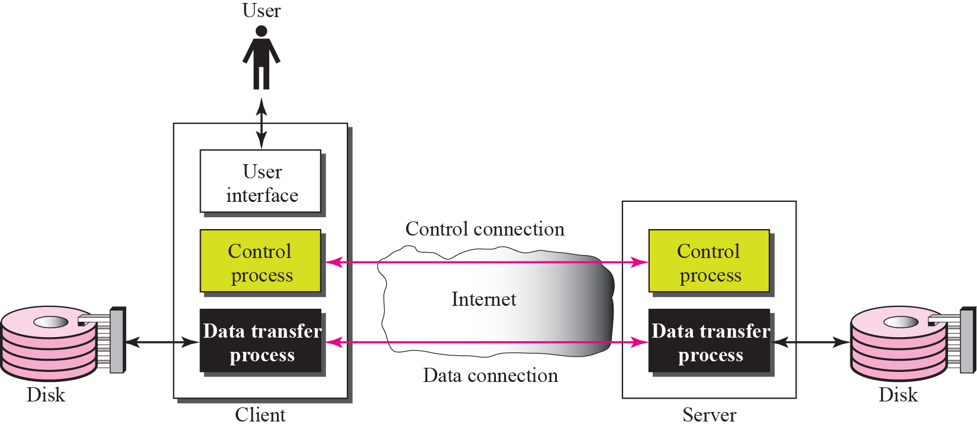
Figure 21.1 FTP

Slide 9
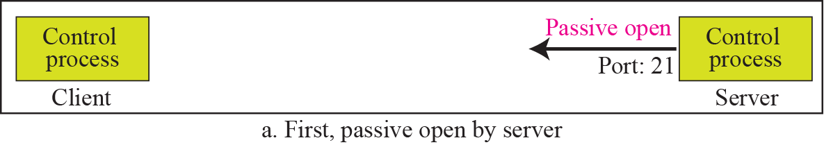
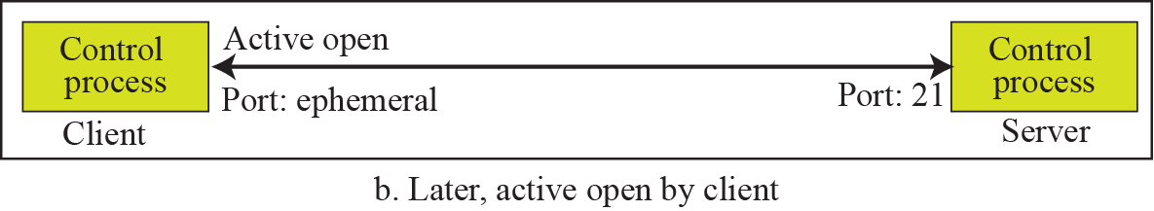
Figure 21.2 Opening the control connection

Slide 10
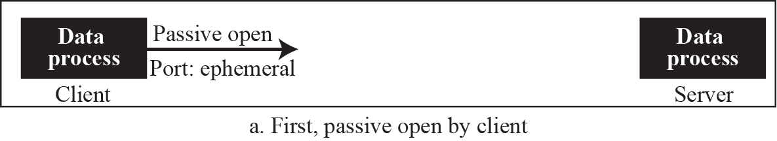
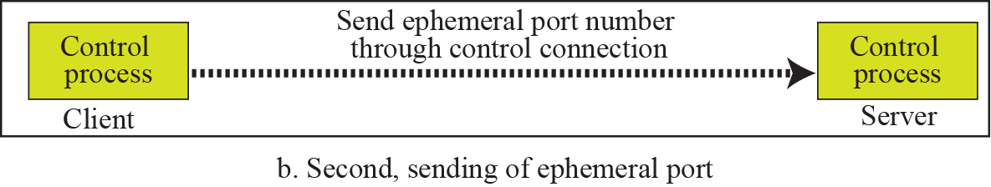
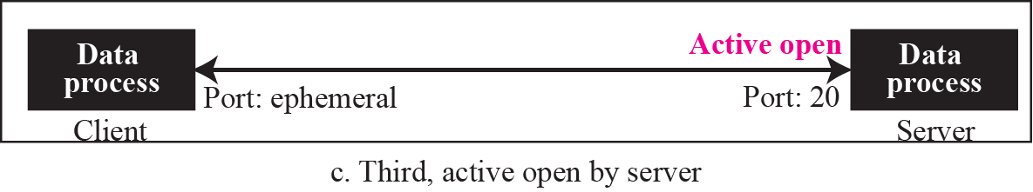
Figure 21.3 Creating the data connection

Slide 11

Figure 21.4 Using the control connection

Slide 12
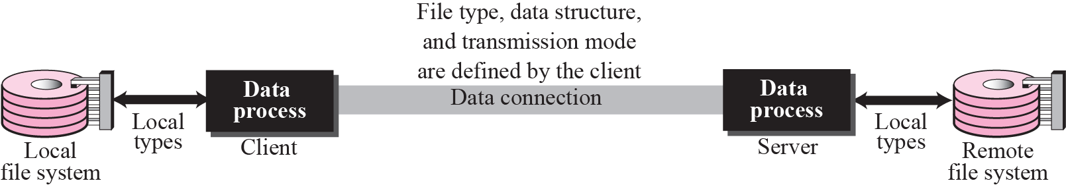
Figure 21.5 Using the data connection

Slide 13
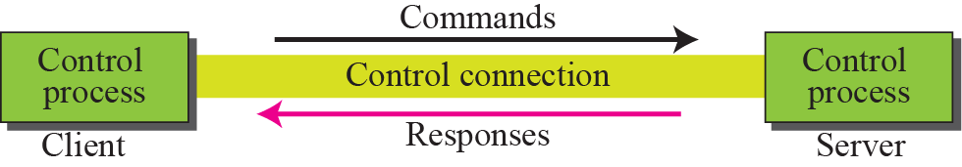
Figure 21.6 Command processing

Slide 14
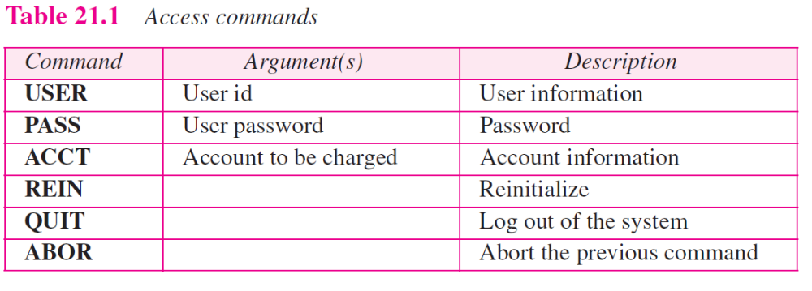

Slide 15
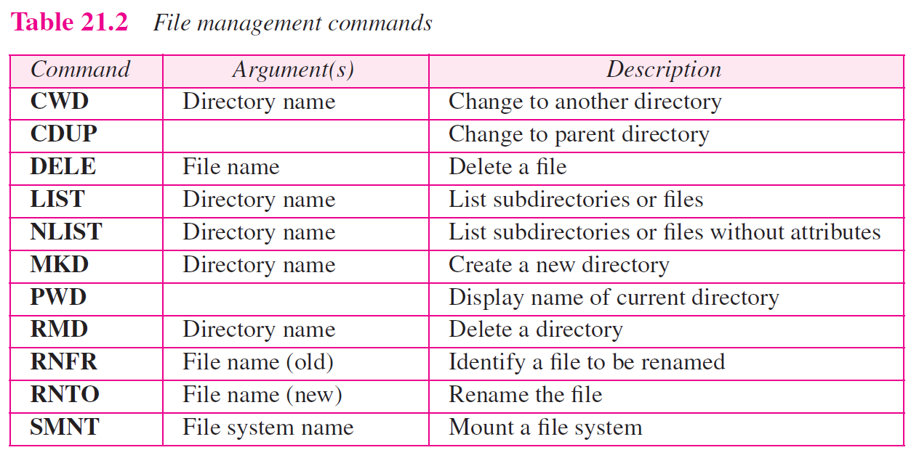

Slide 16
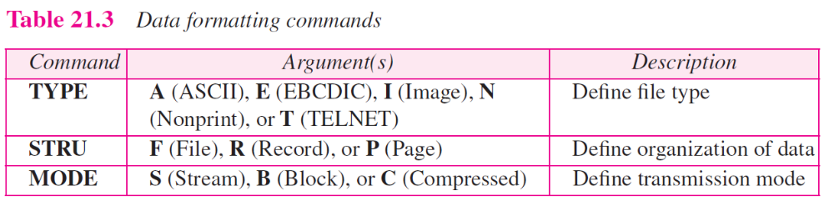

Slide 17
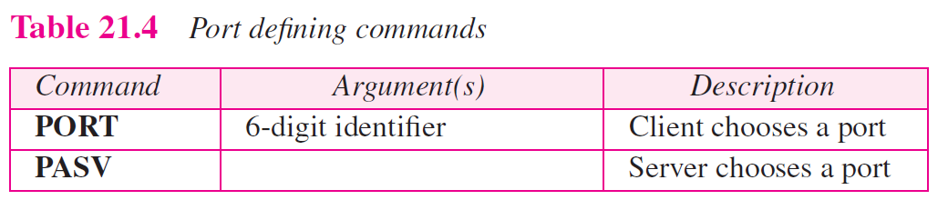

Slide 18
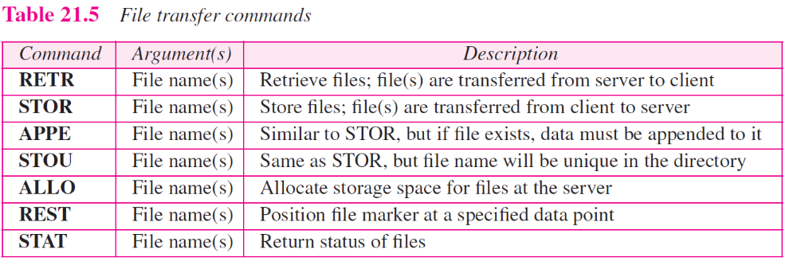

Slide 19
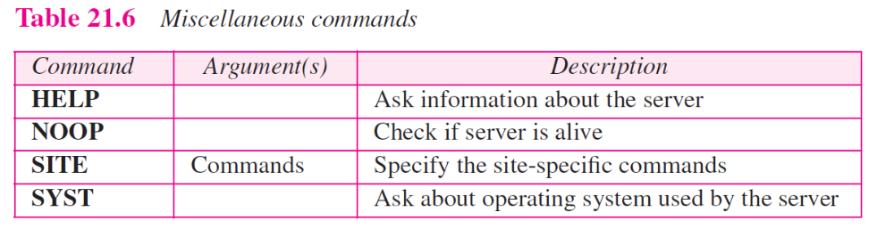

Slide 20
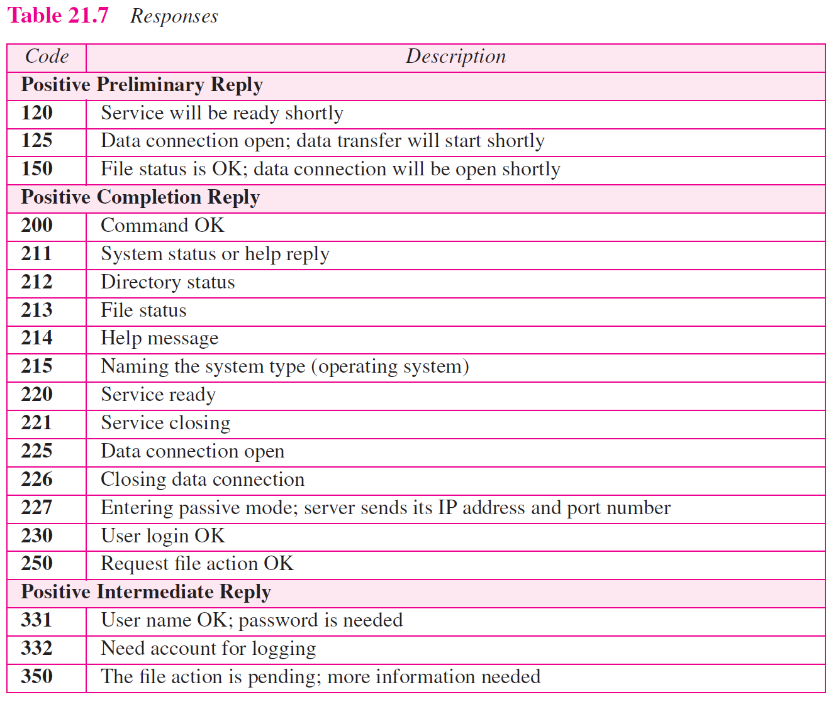

Slide 21
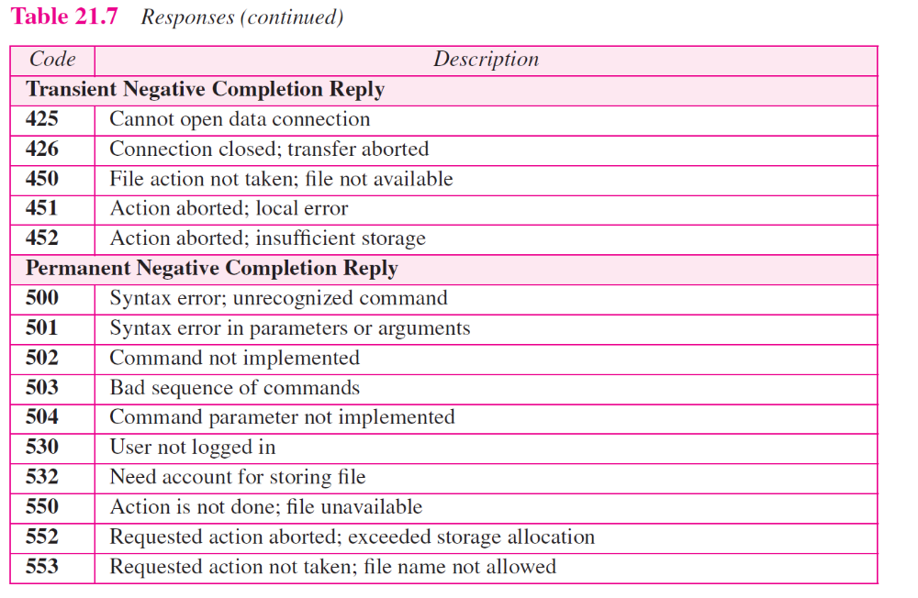

Slide 22
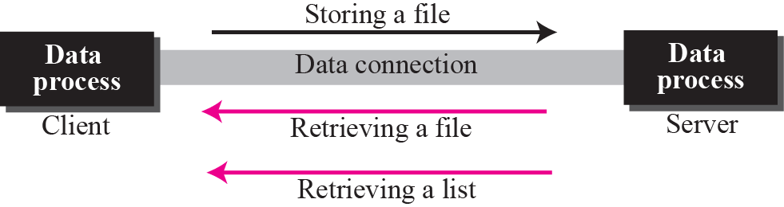
Figure 21.7 File transfer

Slide 23
Example 21.1
Figure 21.8 shows an example of using FTP for retrieving a list of items in a directory.

Slide 24
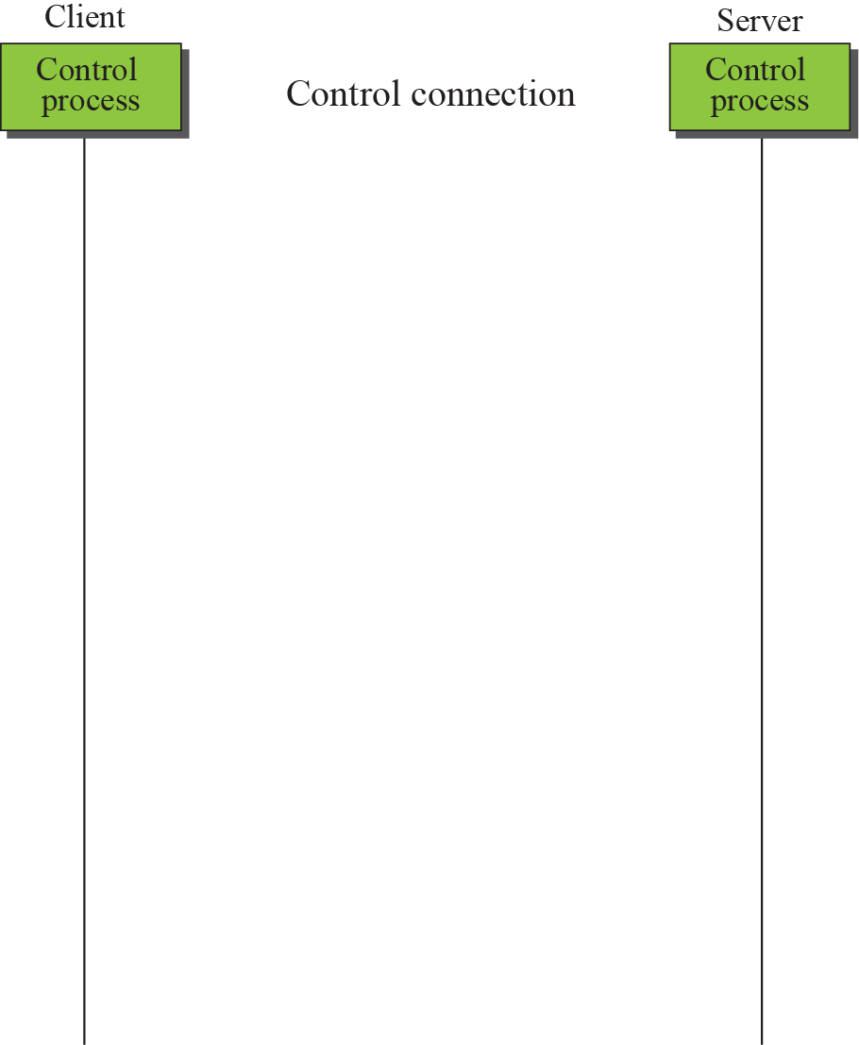
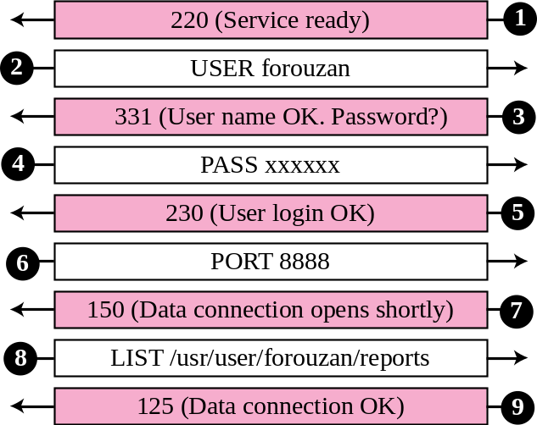
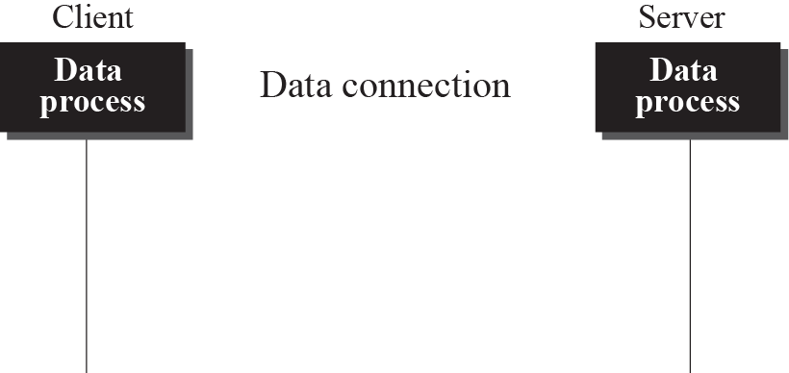
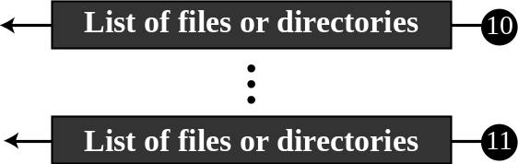

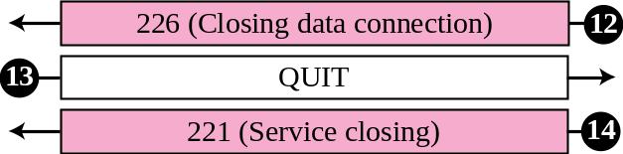
Figure 21.8 Example 21.1

Slide 25
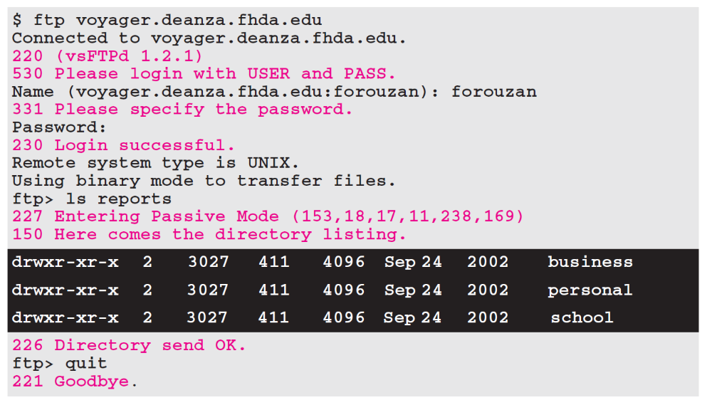
Example 21.2
The following shows an actual FTP session that parallels Example 21.1. The colored lines show the responses from the server control connection; the black lines show the commands sent by the client. The lines in white with black background show data transfer.

Slide 26
Example 21.3
Figure 21.9 shows an example of how an image (binary) file is stored.

Slide 27
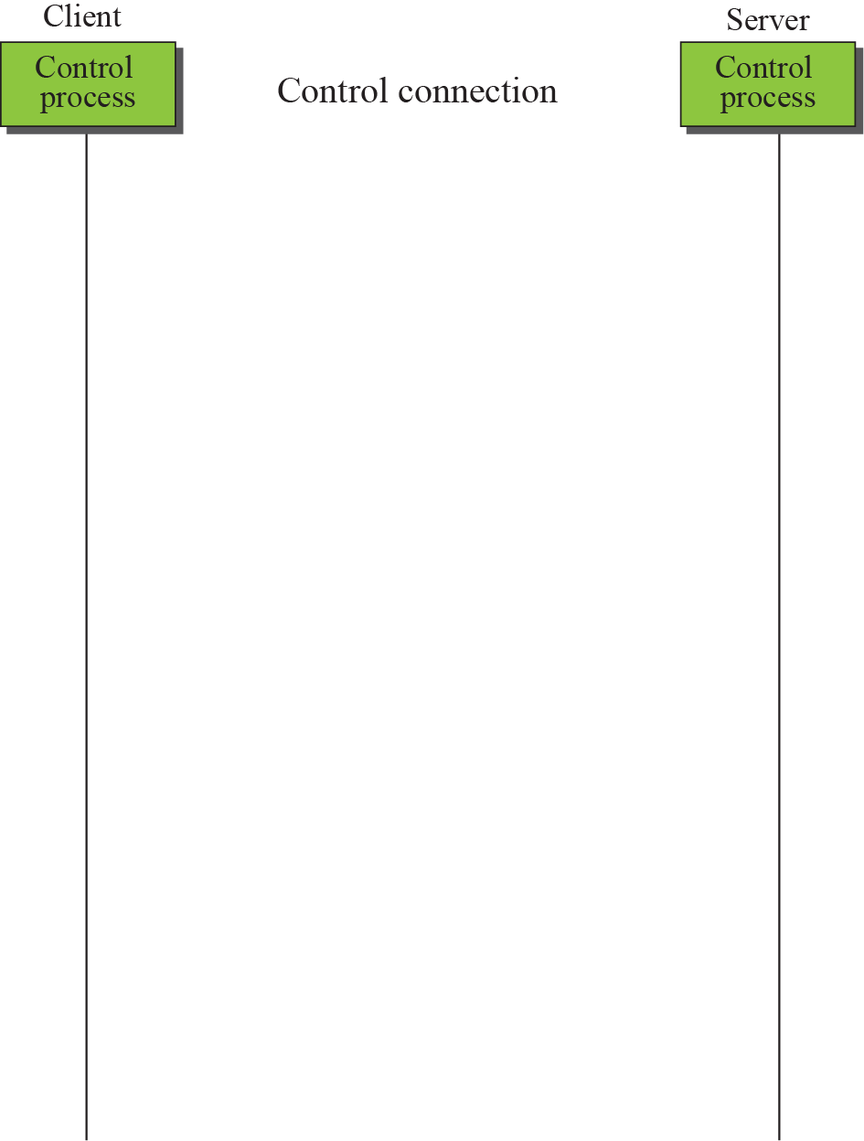
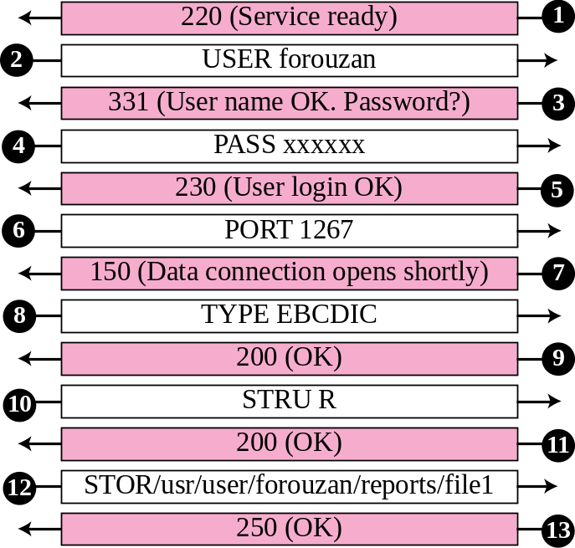
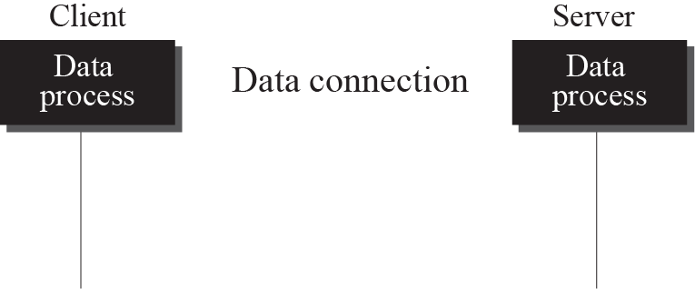

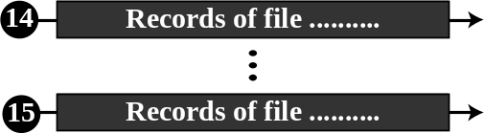
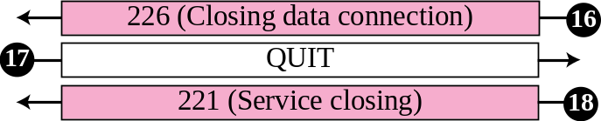
Figure 21.9 Example 21.3

Slide 28
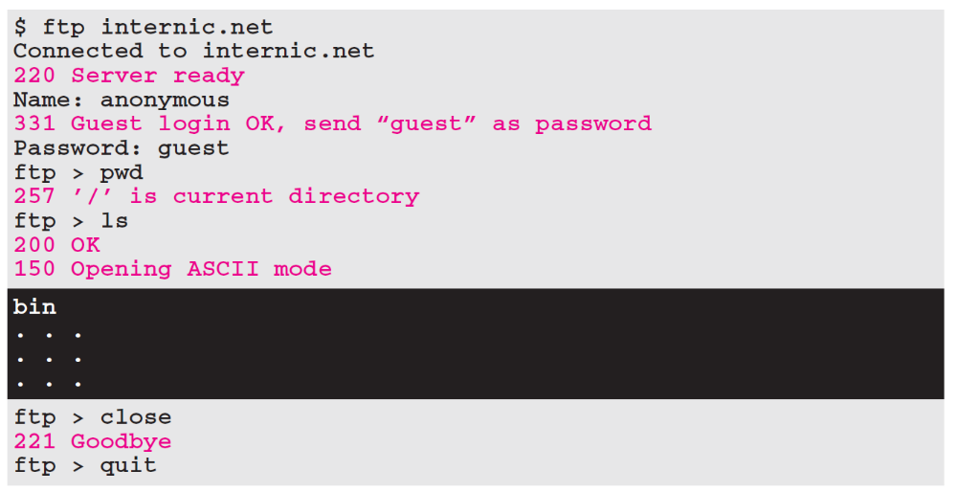
Example 21.4
We show an example of anonymous FTP. We assume that some public data are available at internic.net.

Slide 29
21-2 TFTP
There are occasions when we need to simply copy a file without the need for all of the features of the FTP protocol. For example, when a diskless workstation or a router is booted, we need to download the bootstrap and configuration files. Here we do not need all of the sophistication provided in FTP. We just need a protocol that quickly copies the files.

Slide 30
Topics Discussed in the Section
Messages
Connection
Data Transfer
UDP Ports
TFTP Example
TFTP Options
Security
Applications

Slide 31
Note
TFTP uses the services of UDP on the well-known port 69.

Slide 32
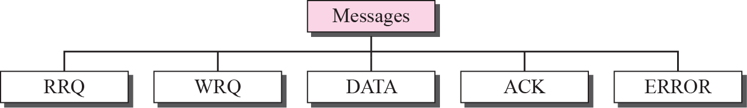
Figure 21.10 Message categories

Slide 33
Figure 21.11 RRQ format

Slide 34
Figure 21.12 WRQ format

Slide 35
Figure 21.13 Data Format

Slide 36
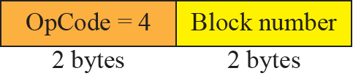
Figure 21.14 ACK format

Slide 37
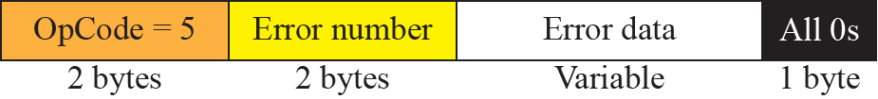
Figure 21.15 ERROR format

Slide 38
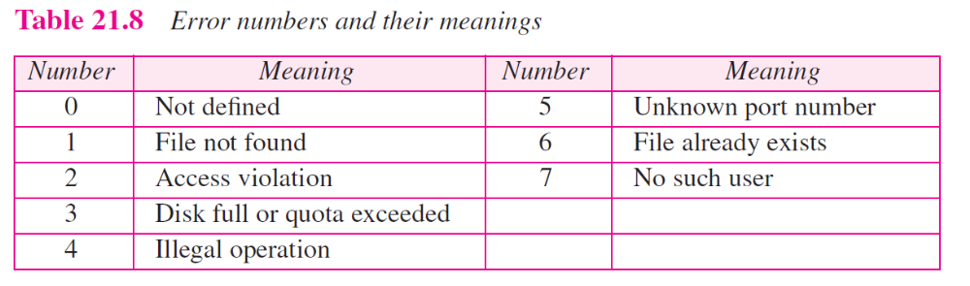

Slide 39
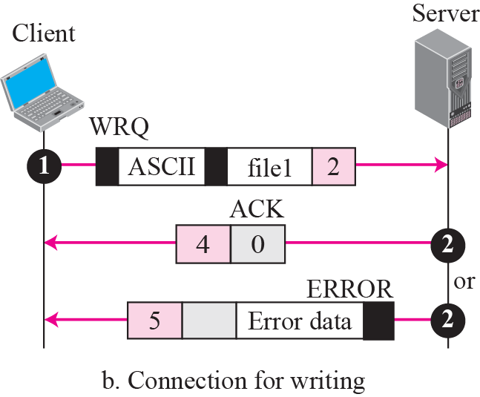
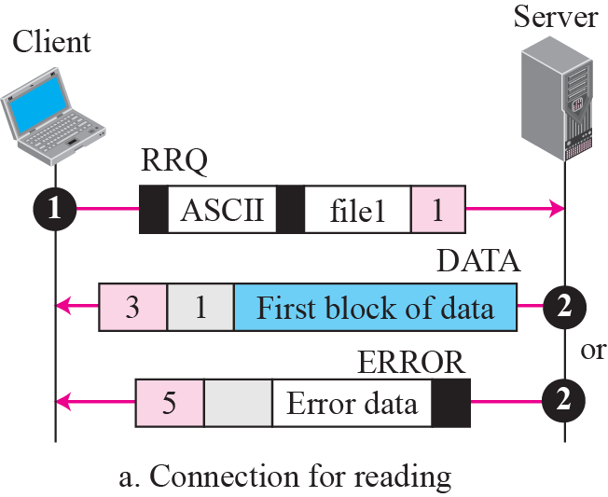
Figure 21.16 Connection establishment

Slide 40
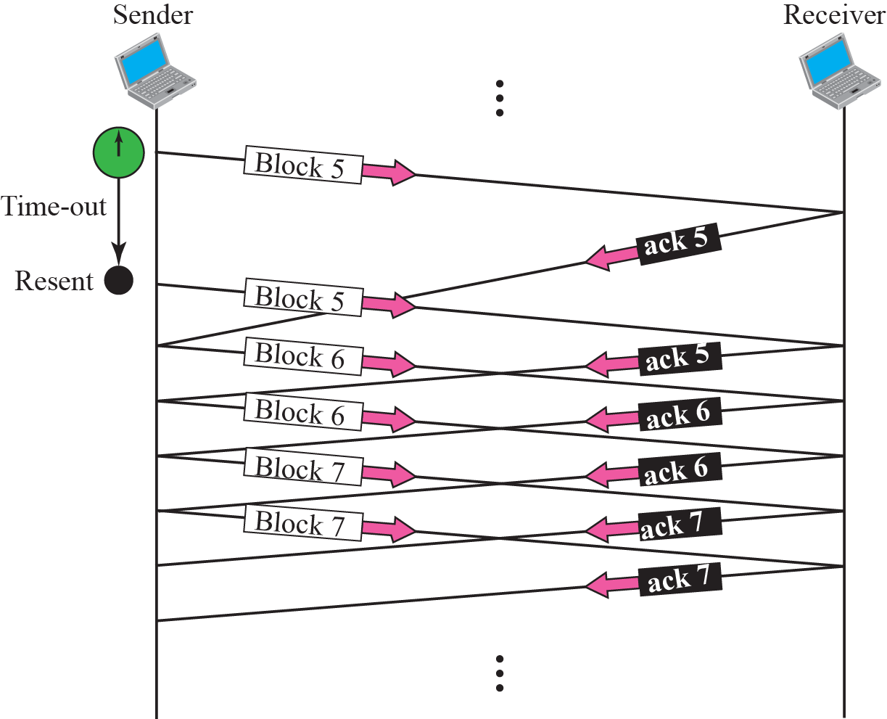
Figure 21.17 Server’s apprentice bug

Slide 41
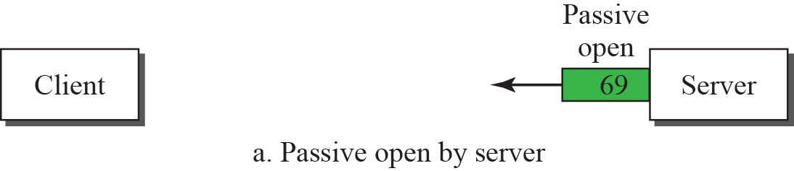
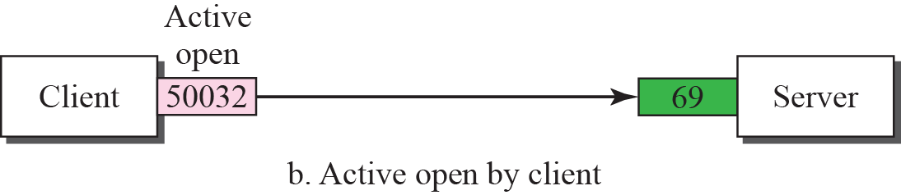
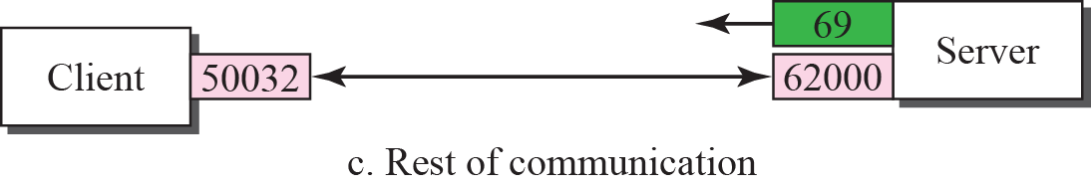
Figure 21.18 UDP port numbers used by TFTP

Slide 42
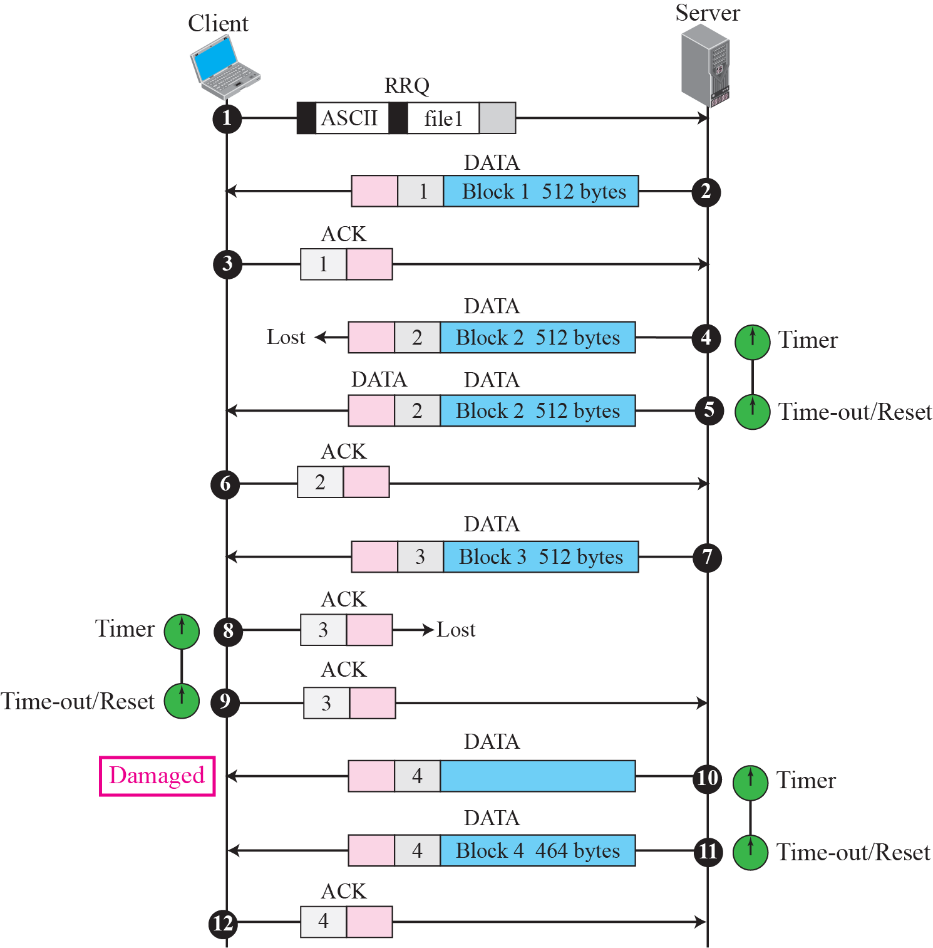
Figure 21.19 TFTP example

Slide 43
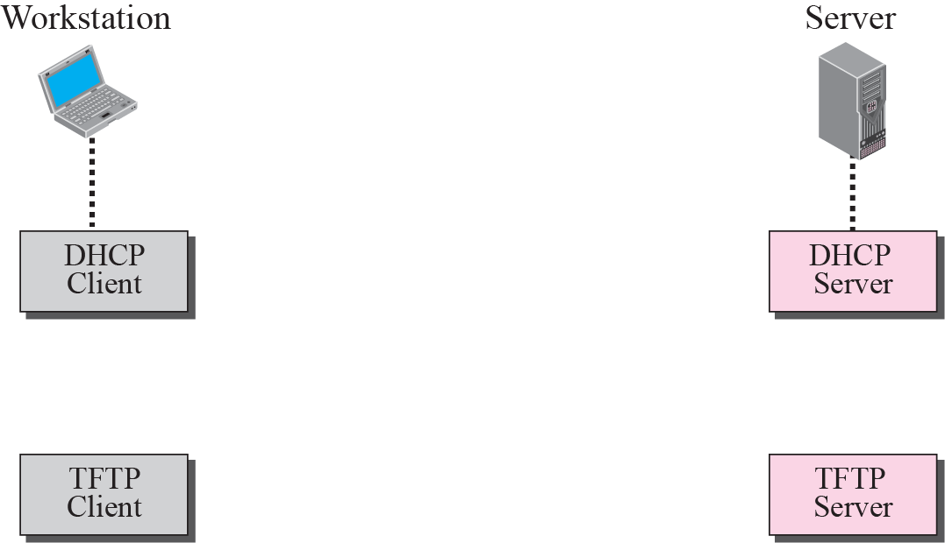

Figure 21.20 Use of TFTP with DHCP

